Slide 1
Microsoft Fabric
How to get started

Slide 2
Ze Plan
Why Fabric – short overview
How to set it up
subscriptions,
rights,
quick management practices
How to access it
Upload sample data file
Show basic queries
Show basic reporting

Slide 3
Why Fabric?

Slide 4
Key Value prop
Democratize Analytics
Simplify
Ops
deployment
Scalability
Pricing
Single source of truth
One Security - Open but secure
Notes:
Ease of use
One Lake is OneDrive for your data
Unification, simplification and democratisation of Analytics in the organisation.

Slide 5
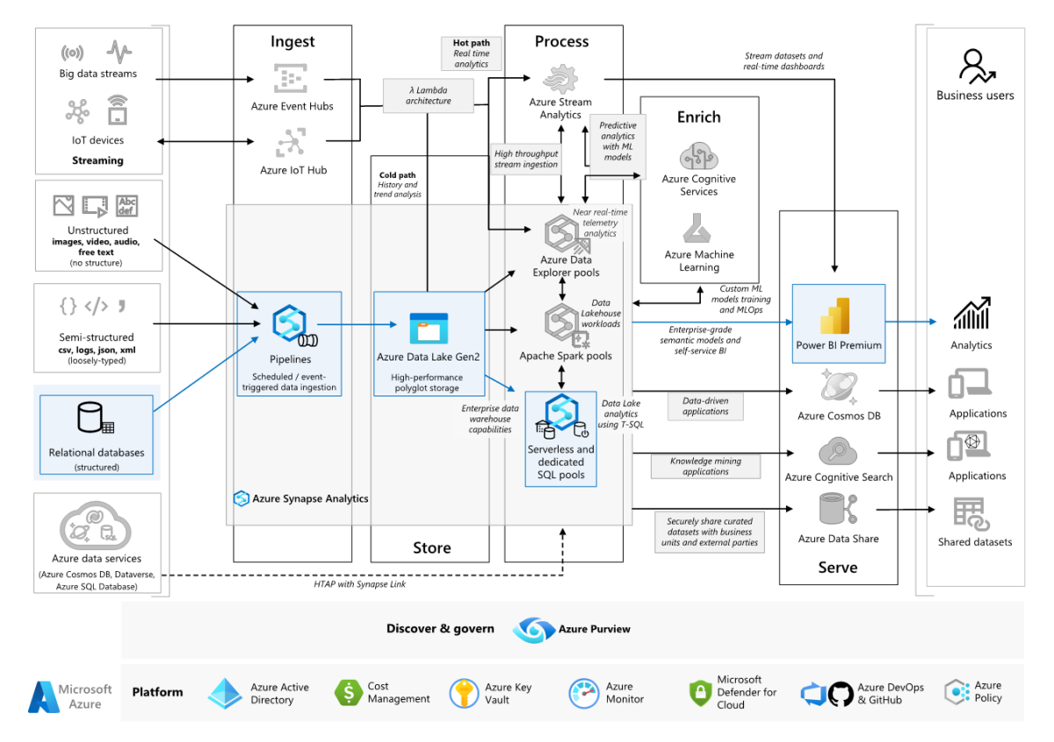
Enterprise business intelligence
Notes:
Enterprise business intelligence
https://learn.microsoft.com/en-us/azure/architecture/example-scenario/analytics/enterprise-bi-synapse

Slide 6






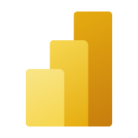


Microsoft Fabric
The data platform for the era of AI
Data
Factory
Synapse Data Warehousing
Synapse Data
Engineering
Synapse Data
Science
Synapse Real
Time Analytics
Power BI
Reflex
OneLake
Intelligent data foundation
Notes:
But first- what’s Fabric?
Fabric provides a unified intelligent data foundation for all analytics workloads and integrates Power BI, Data Factory and the next generation of Synapse to offer customers a price performant and easy to manage, modern analytics solution
Reflex – can be “Data Activator”
7 workloads
Data Factory
Synapse Data Engineering
Synapse Data Science
Synapse Data Warehousing
Synapse Real Time Analytics
Power BI
Data Activator(*)
Also Data Activator (ain’t there yet!)
And Copilot
Microsoft Fabric is a unified platform supporting data modeling, data warehousing––all the way to business intelligence. The business model is meant to support the unified experience by simplifying the purchase experience.
Customers no longer need to purchase separate compute for each workload. In addition, by decoupling storage and compute, customers can independently size compute power irrespective of storage needs.

Slide 7
Transforming the Data Estate
Current Synapse PaaS
Future Trident SaaS
Upfront provisioning and configuration
Limitations with Synapse Workspaces
Scalability issues
Data Duplication
IT bottleneck, latency
Data Sharing not robust
Fully managed SaaS platform
Enterprise capabilities are pre-provisioned as part of the tenant
Built in governance
Flexible workspaces that support data product sharing
Full separation of storage and compute

Slide 8
Things To come
Inclusion of copilot across all Fabric elements

Slide 9
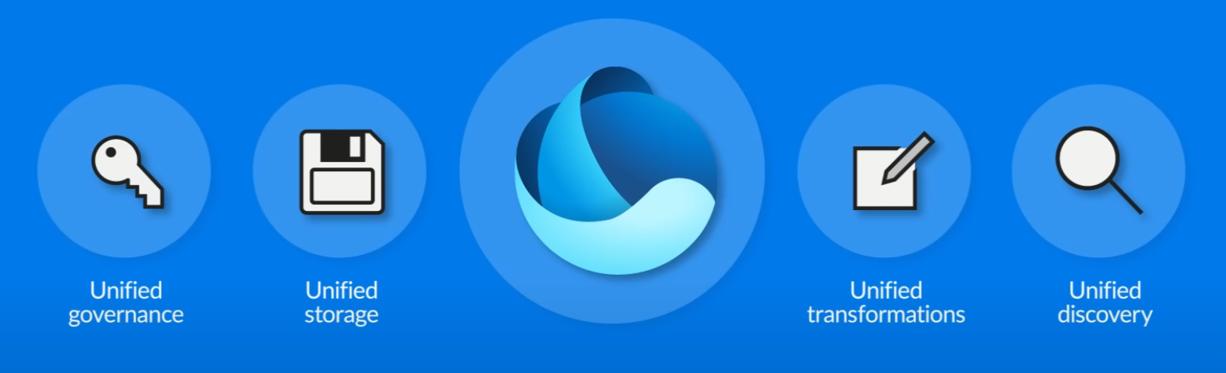
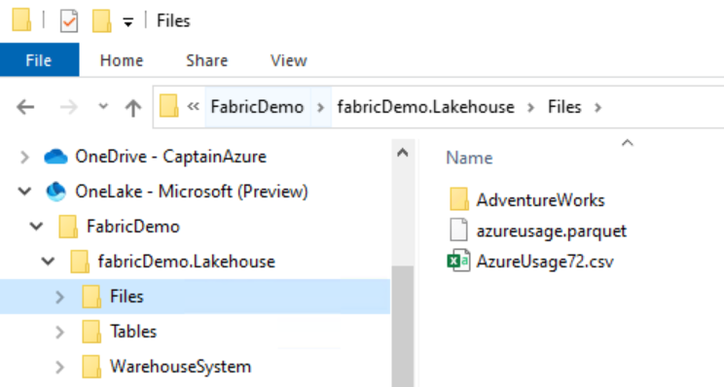
One Lake – OneDrive for all your data
Notes:
One Lake - we're trying to make it as OneDrive for data
OneLake uses open source file format delta parquet which can be read and worked with all kinds of different workloads
Any file format is welcome in OneLake
OneLake aims to provide you a data lake as service without you needing to build it yourself. For years, you have had “OneDrive” for all your documents. Now, you have “OneLake” for all your data.
OneLake File Explorer
https://learn.microsoft.com/en-us/fabric/onelake/onelake-file-explorer
Understanding OneLake within Microsoft Fabric
https://www.youtube.com/watch?v=wEcRTSNhtLg
Users cannot create OneLake storage. OneLake storage (ADLS Gen2) managed by OneLake API is attached to Trident tenant. When a workspace is created, a folder is created in OneLake storage (ADLS Gen2 behind the scenes) on a customer tenant.
What this means that for every Trident tenant, you will always have exactly one OneLake. Never two, never 0. There is no infrastructure to setup or manage.
The concept of a tenant is a unique benefit of a SaaS service. It allows us to automatically provide a single management and governance boundary for an entire organization which is ultimately under the control of a tenant admin. The admin sets this initial boundary and any data which lands in OneLake will automatically take part in out of the box data governance such as data linage, data protection, certification, catalog integration, etc. All data is ultimately under the control of a tenant admin. However, it is important that different business groups are able to work independently without going through a central gatekeeper. An Office user does not need to coordinate with their Office admin to create a new Teams channel or SharePoint site.
OneLake enables distributed ownership through workspaces. Different workspaces allow different parts of the organization to work independently while still contributing to the same data lake. Each workspace can have its own administrator, access control, region and capacity for billing. Creating a workspace is very lightweight. It inherits the rules set by the tenant admin so there if no need to reimplement the same governance or spend time trying to get different resources to talk to each other. Workspace admins can further control access to the data within their workspace as needed.

Slide 10
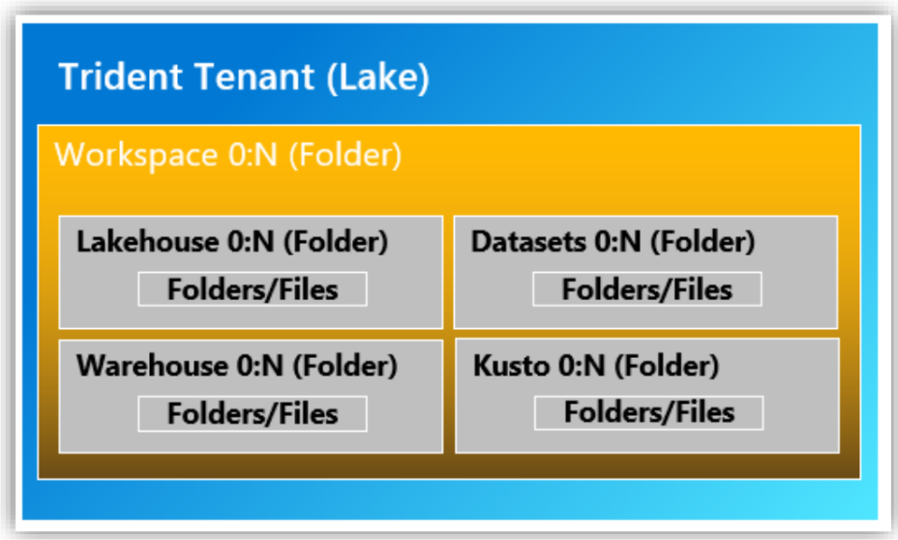
One Lake
Workspace A
Capacity A
OneLake
Workspace B
Capacity B
Workspace C
Each tenant will have only one OneLake, and any tenant can access files in other tenants OneLake via shortcuts

Slide 11
OneLake for all data 2 “The OneDrive for data”
OneLake
Data
warehousing
Data
engineering
Data integration
Data
science
Real-time
analytics
Business intelligence
A single unified logical SaaS data lake for the whole organization (no silos)
Organize data into domains
Foundation for all Fabric data items
Provides full and open access through industry standard APIs and formats to any application (no lock-in)
OneLake
One Copy
One Security
Intelligent data fabric
OneLake Data Hub
Notes:
Starting with OneLake itself. OneLake provides you a single data lake for your entire organization.

Slide 12
A single unified SaaS data lake “No silos”
OneLake comes automatically provisioned with every Fabric tenant with no infrastructure to manage.
Data
warehousing
Data
engineering
Data integration
Data
science
Real-time
analytics
Business intelligence
Any data in OneLake works with out-of-the-box governance such as data lineage, data protection, certification, catalog integration, etc. All data is ultimately under the control of a tenant admin.
Unified management and governance
OneLake
OneLake enables distributed ownership. Different workspaces allow different parts of the organization to work independently while still contributing to the same data lake. Each workspace can have its own administrator, access control, region and capacity for billing.
Workspace
POS sales
Workspace online sales
Workspace
customer
Workspace
ads
Workspace
expenses
Notes:
What this means that for every Fabric tenant, you will always have exactly one OneLake. Never two, never 0. There is no infrastructure to setup or manage.
The concept of a tenant is a unique benefit of a SaaS service. It allows us to automatically provide a single management and governance boundary for an entire organization which is ultimately under the control of a tenant admin. The admin sets this initial boundary and any data which lands in OneLake will automatically take part in out of the box data governance such as data linage, data protection, certification, catalog integration, etc. All data is ultimately under the control of a tenant admin. However, it is important that different business groups are able to work independently without going through a central gatekeeper. An Office user does not need to coordinate with their Office admin to create a new Teams channel or SharePoint site.
OneLake enables distributed ownership through workspaces. Different workspaces allow different parts of the organization to work independently while still contributing to the same data lake. Each workspace can have its own administrator, access control, region and capacity for billing. Creating a workspace is very lightweight. It inherits the rules set by the tenant admin so there if no need to reimplement the same governance or spend time trying to get different resources to talk to each other. Workspace admins can further control access to the data within their workspace as needed.

Slide 13
Integration capabilities
Bring your data from anywhere

Slide 14
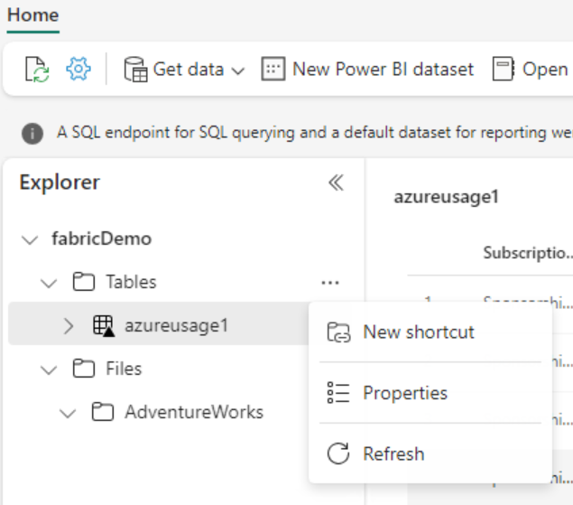
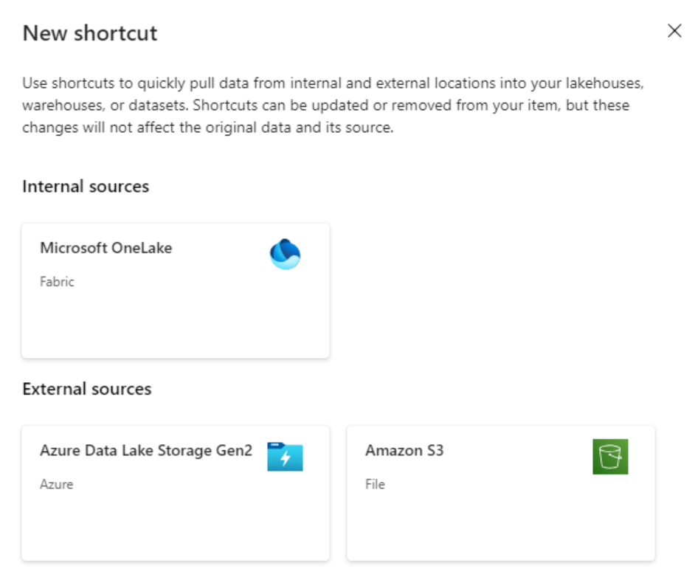
Shortcuts point to other storage locations and make files appear in OneLake as actual copies – without actually duplicating the data
Notes:
https://learn.microsoft.com/en-us/fabric/onelake/onelake-shortcuts

Slide 15
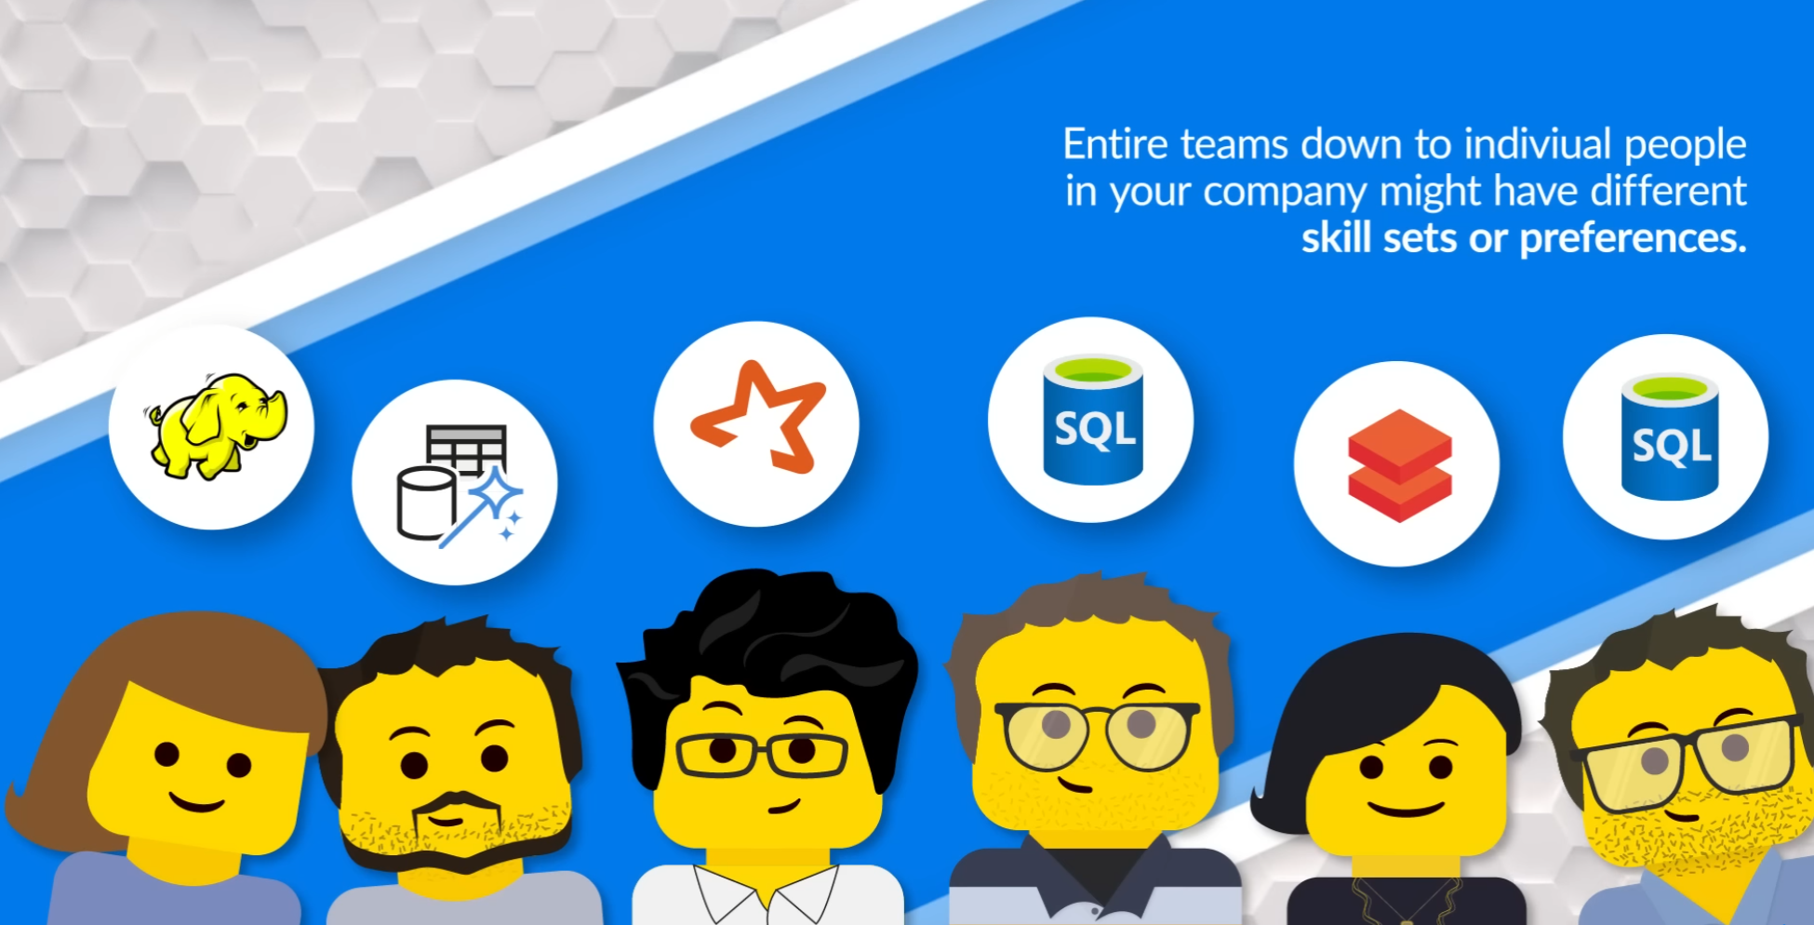
Everyone is welcome

Slide 16
Fabric Tenant creation

Slide 17
Prerequisites
M365 tenant with PowerBI
M365 Developer (includes 25*E5 and PowerBI Pro)
External subscription*
Azure Subscription with an Admin access
External tenant – works
MS Visual Studio Azure Benefit – works
FDPO* – does not work (June’23)
Azure VM
* MSFT internal

Slide 18
Deployment strategies
Existing MSIT deployment – quick
Create workspace in MSFT PBI
Start Fabric trial
“Start Fabric Trial” in PBI
New tenant experience

Slide 19
MSFT Internal
While a customer use app.powerbi.com, for our internal usage and testing purposes, we can use the following:
https://msit.powerbi.com/?trident=1 – more stable environment but does not yet have the latest version.
http://dxt.powerbi.com/?trident=1 – intermediate environment, less stable but higher version that MSIT.
http://daily.powerbi.com/?trident=1 – less stable environment but has the highest version available. It is used by PG.
Notes:
Please turn on the feature switch '?trident=1' to have Trident enabled experiences (you should have PPU licenses by default as Microsoft employees/vendor).

Slide 20
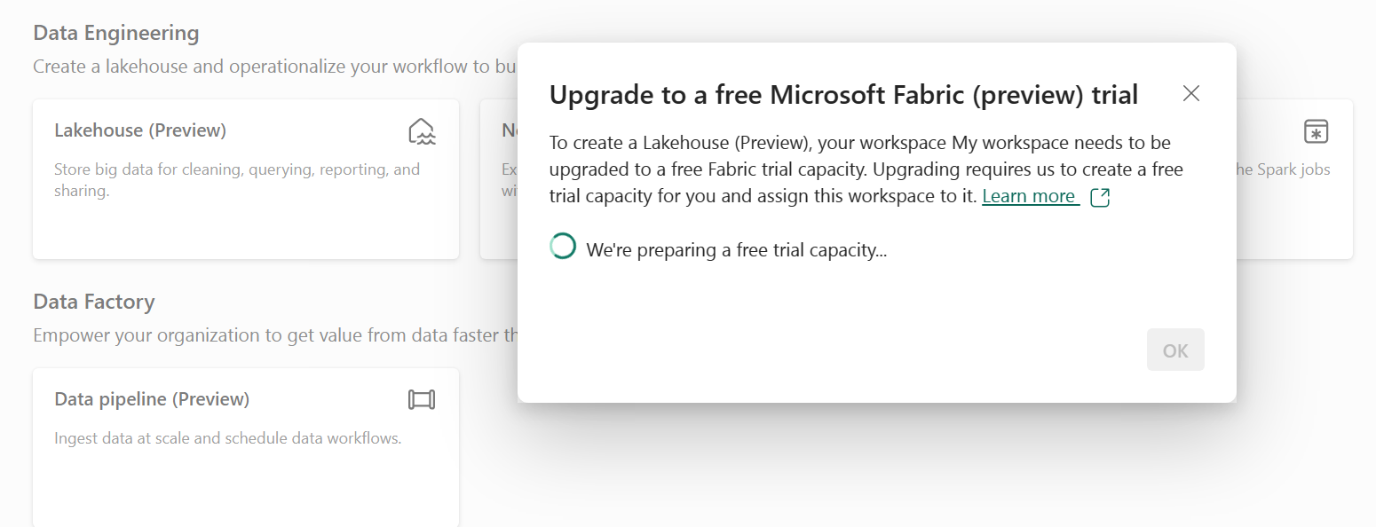
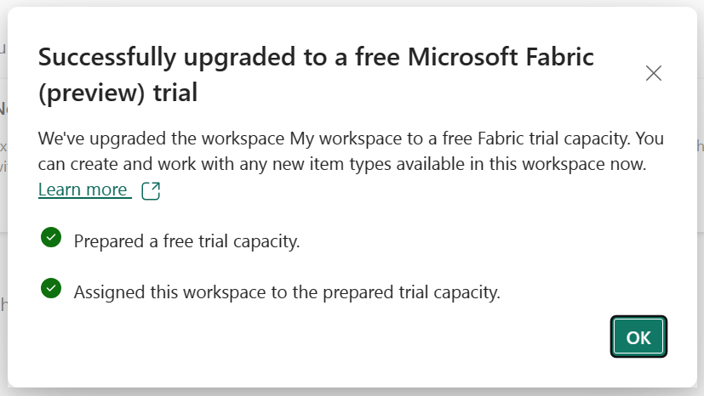
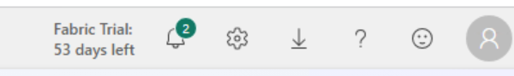
Existing tenant Preview
https://aka.ms/try-fabric
Microsoft Fabric (Preview) trial
Buy a Microsoft Fabric subscription
Notes:
App.powerbi.com
(if logged in you will be redirected to your PBI tenant)
My Workspace
New -> Show All
Click on any of Fabric Features
Careful with this – there be dragons.

Slide 21
New tenant
End customer experience

Slide 22
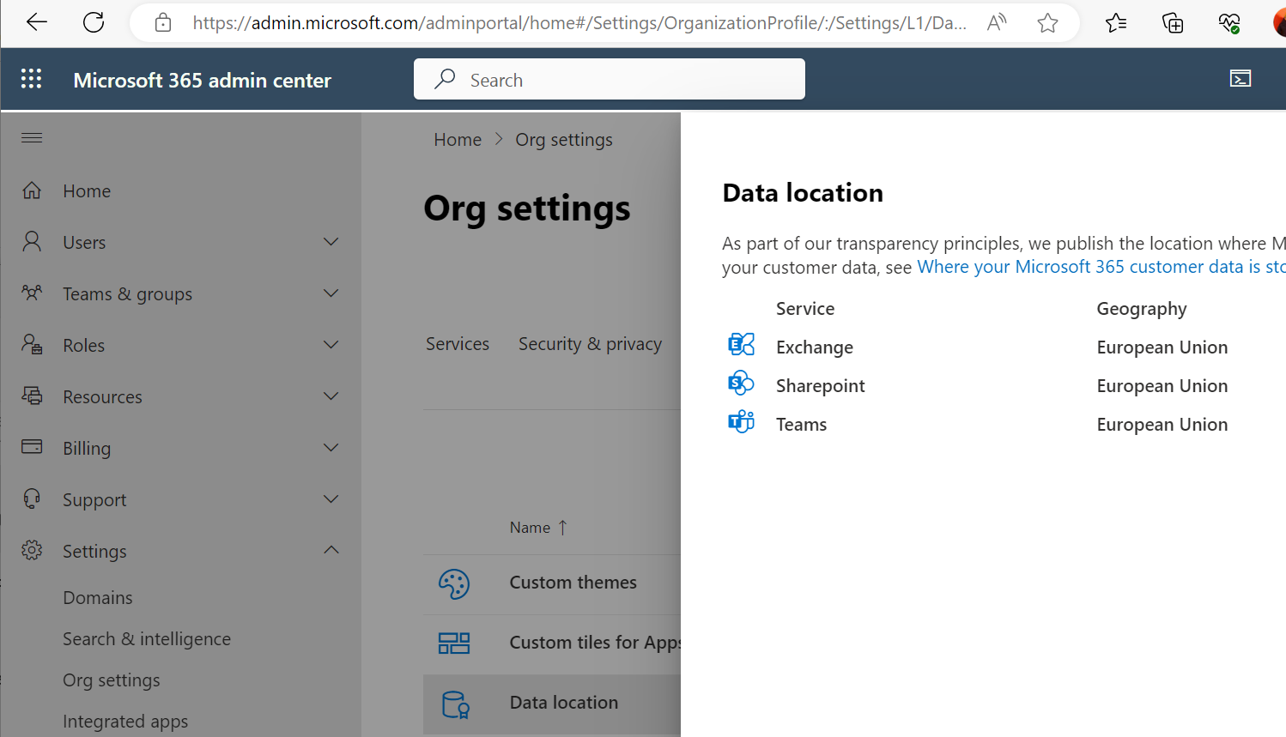
M365 tenant location
Notes:
https://admin.microsoft.com/

Slide 23
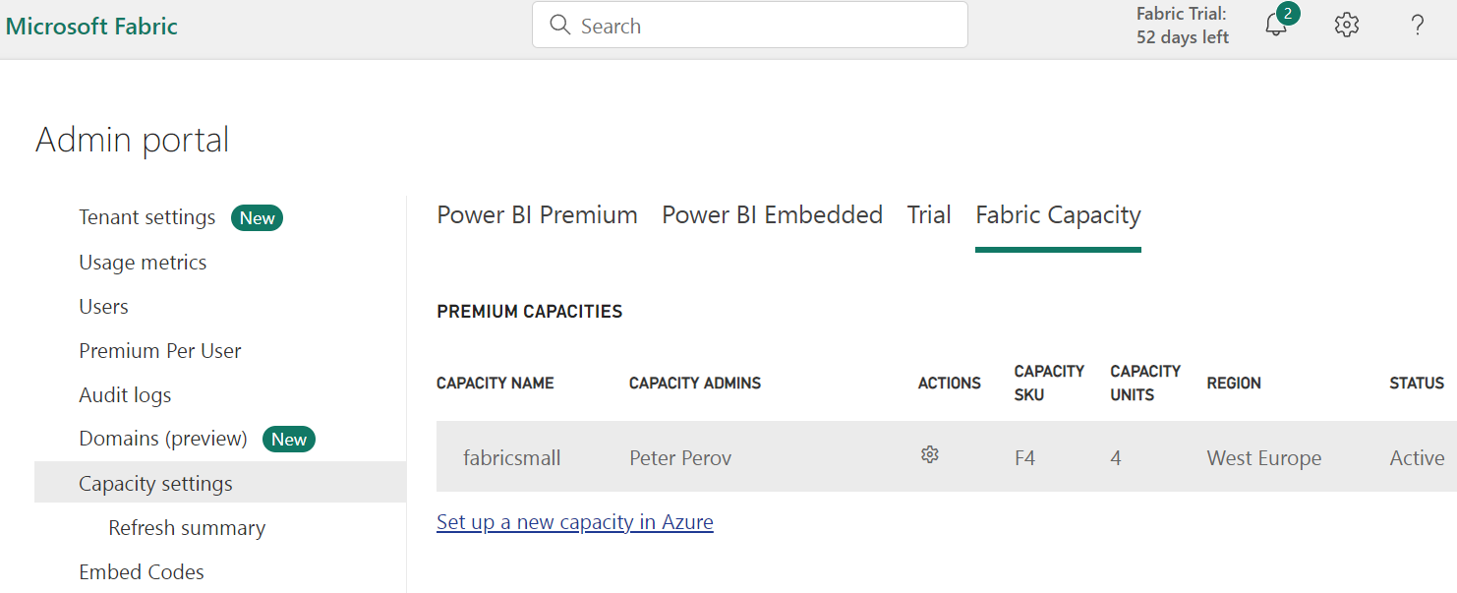
PBI Capacity Settings
Notes:
You can actually create capacity from PBI portal
Capacity usage report is also there (you will need to install “Microsoft Fabric Capacity Metrics” app.

Slide 24
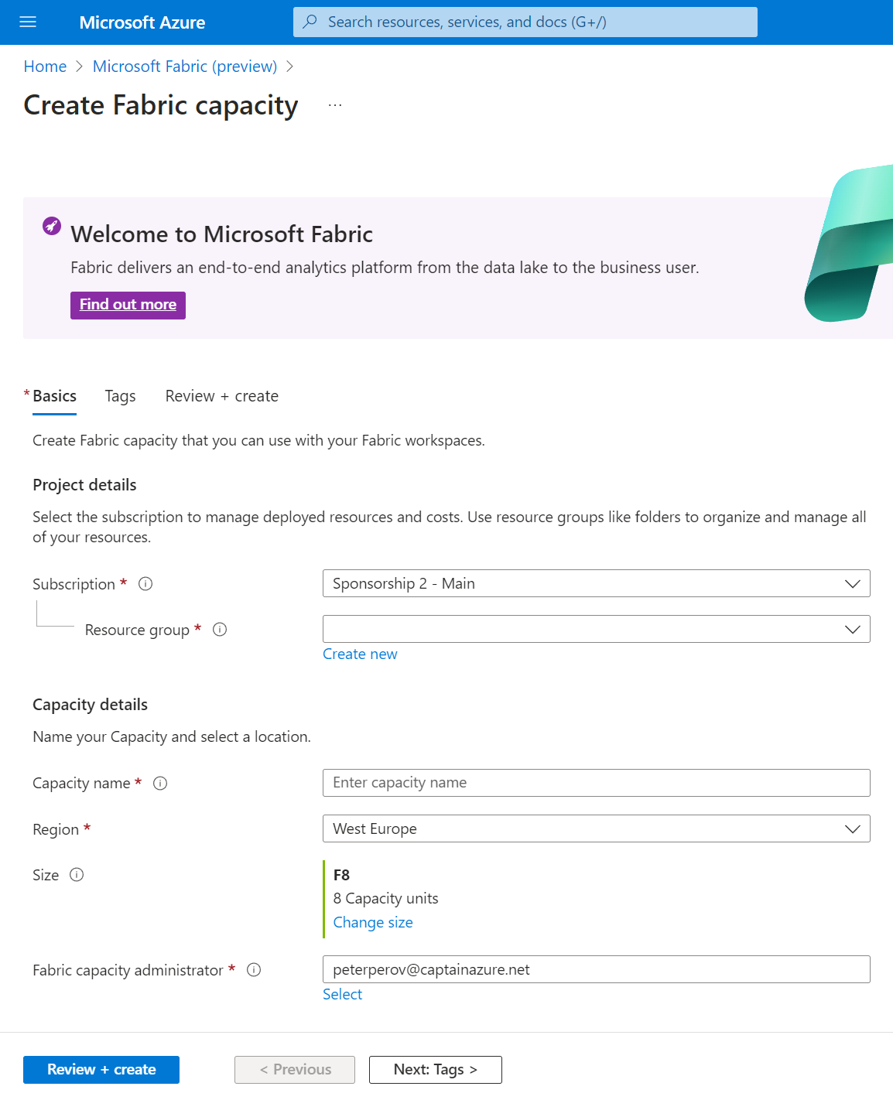
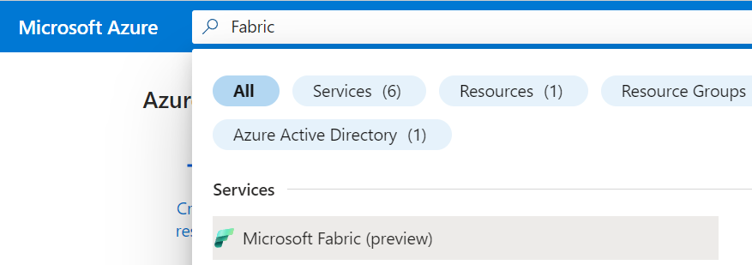
Create Fabric on Azure Portal

Slide 25
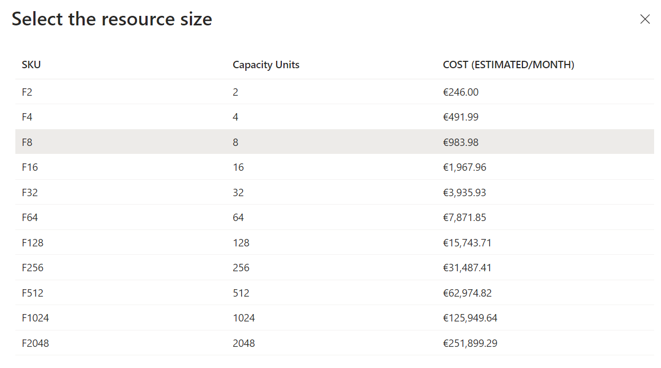
Choose Capacity (preview! June’23)
Notes:
PREVIEW PRICING, INDICATION ONLY
PBI v-cores will evolve to Compute Units (group of 8 v-cores)
SKU types
Microsoft Fabric has an array of capacities that you can buy. The capacities are split into Stock Keeping Units (SKU). Each SKU provides a different amount of computing power, measured by its Capacity Unit (CU) value. Refer to the Capacity and SKUs table to see how many CUs each SKU provides.
Microsoft Fabric operates on two types of SKUs:
Azure - Billed per second with no commitment.
Microsoft 365 - Billed monthly or yearly, with a monthly commitment
Azure SKUs
Azure SKUs, also known as F SKUs, are the recommended capacities for Microsoft Fabric. You can use your Azure capacity for as long as you want without any commitment. Pricing is regional and billing is made on a per second basis with a minimum of one minute.
Azure capacities offer the following improvements over the Microsoft 365 SKUs.
Pay as you go with no time commitment.
You can scale your capacity up or down using the Azure portal.
You can pause and resume your capacity as needed. This feature is designed to save money when the capacity isn't in use.
Azure cost management.
Azure Monitor Metrics.
Microsoft 365 SKUs
Microsoft 365 SKUs, also known as P SKUs, are Power BI SKUs that also support Fabric when it is enabled on top of your Power BI subscription. EM SKUs do not support Microsoft Fabric.

Slide 26
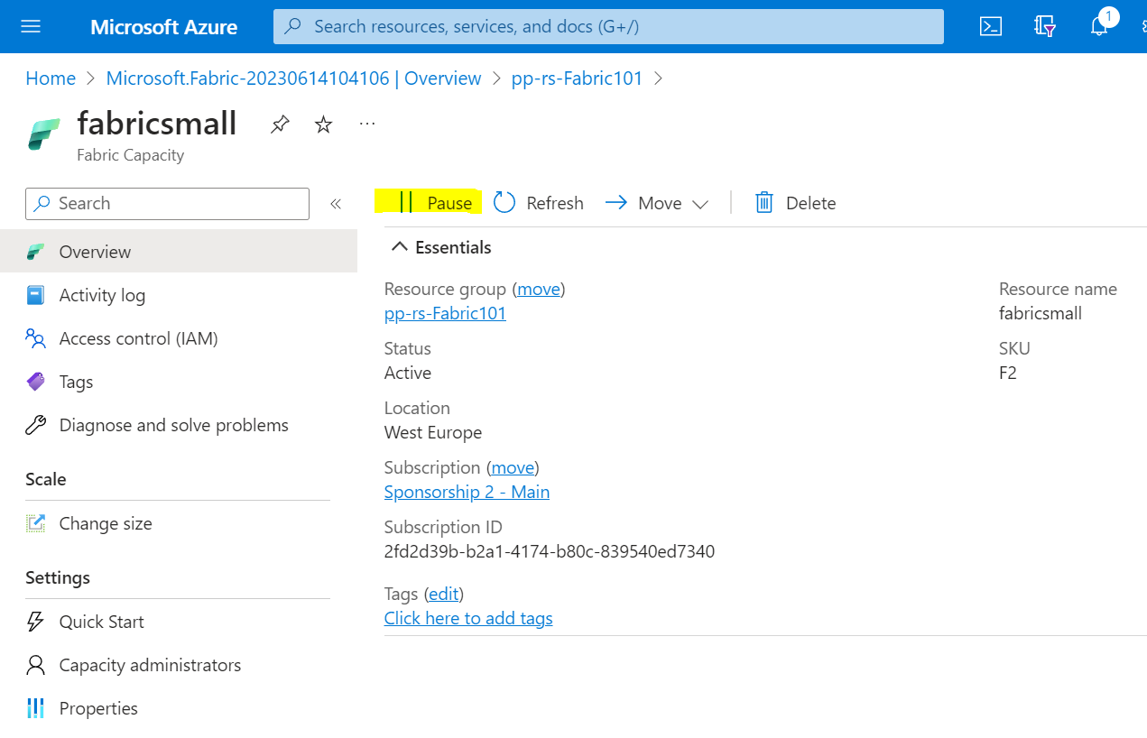
Capacity can be paused!
Notes:
Logic App to pause Capacity

Slide 27
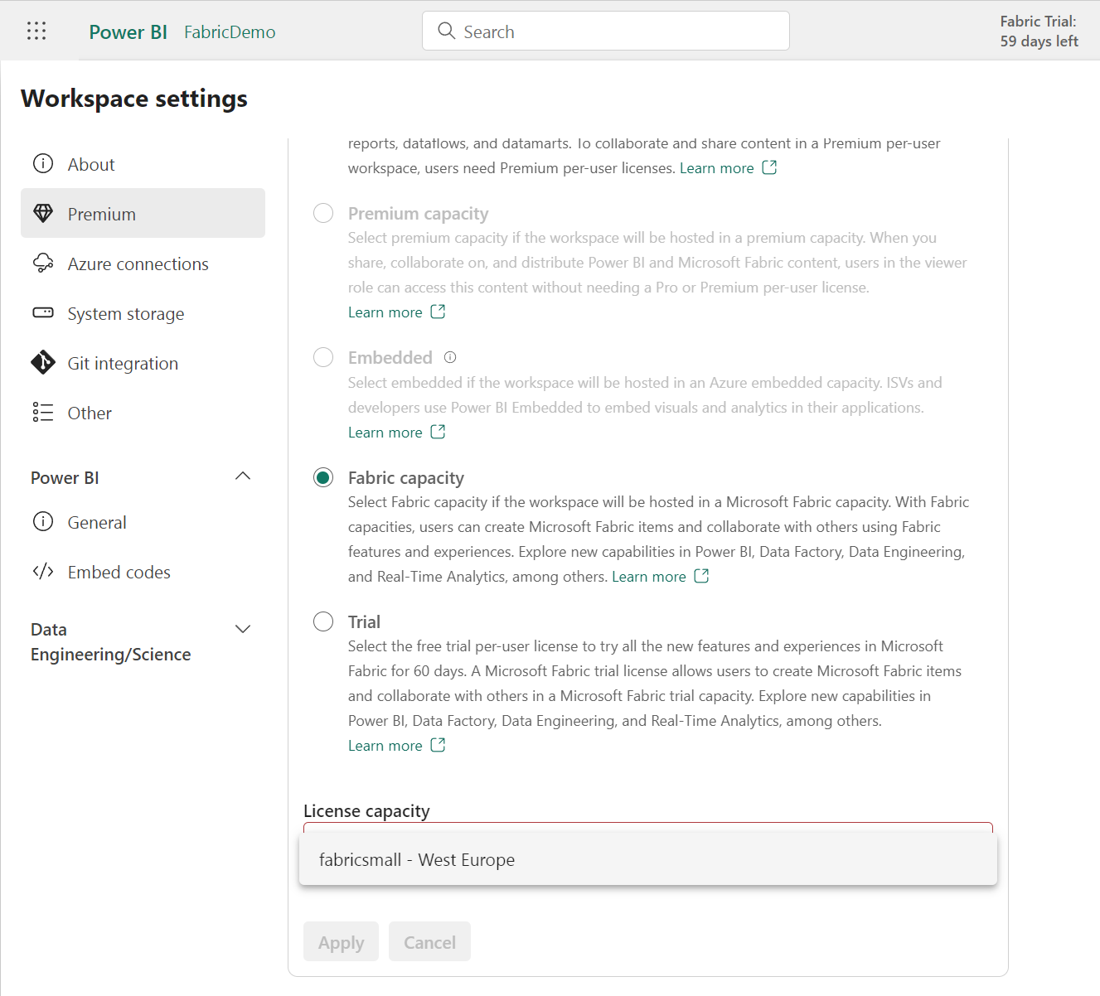
PowerBI Admin page
App.powerbi.com
Workspace Settings
Premium
Notes:
Create workspace
Assign capacity in PBI Admin page

Slide 28
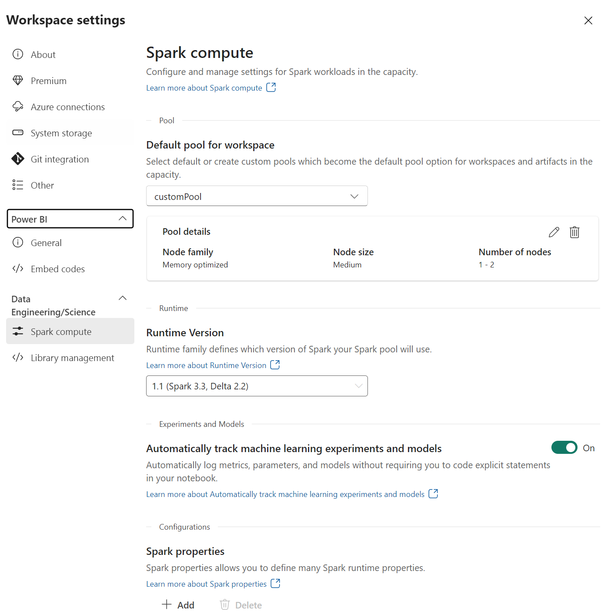
Spark Settings
Notes:
Manage Apache Spark libraries in Microsoft Fabric
https://learn.microsoft.com/en-us/fabric/data-engineering/library-management

Slide 29
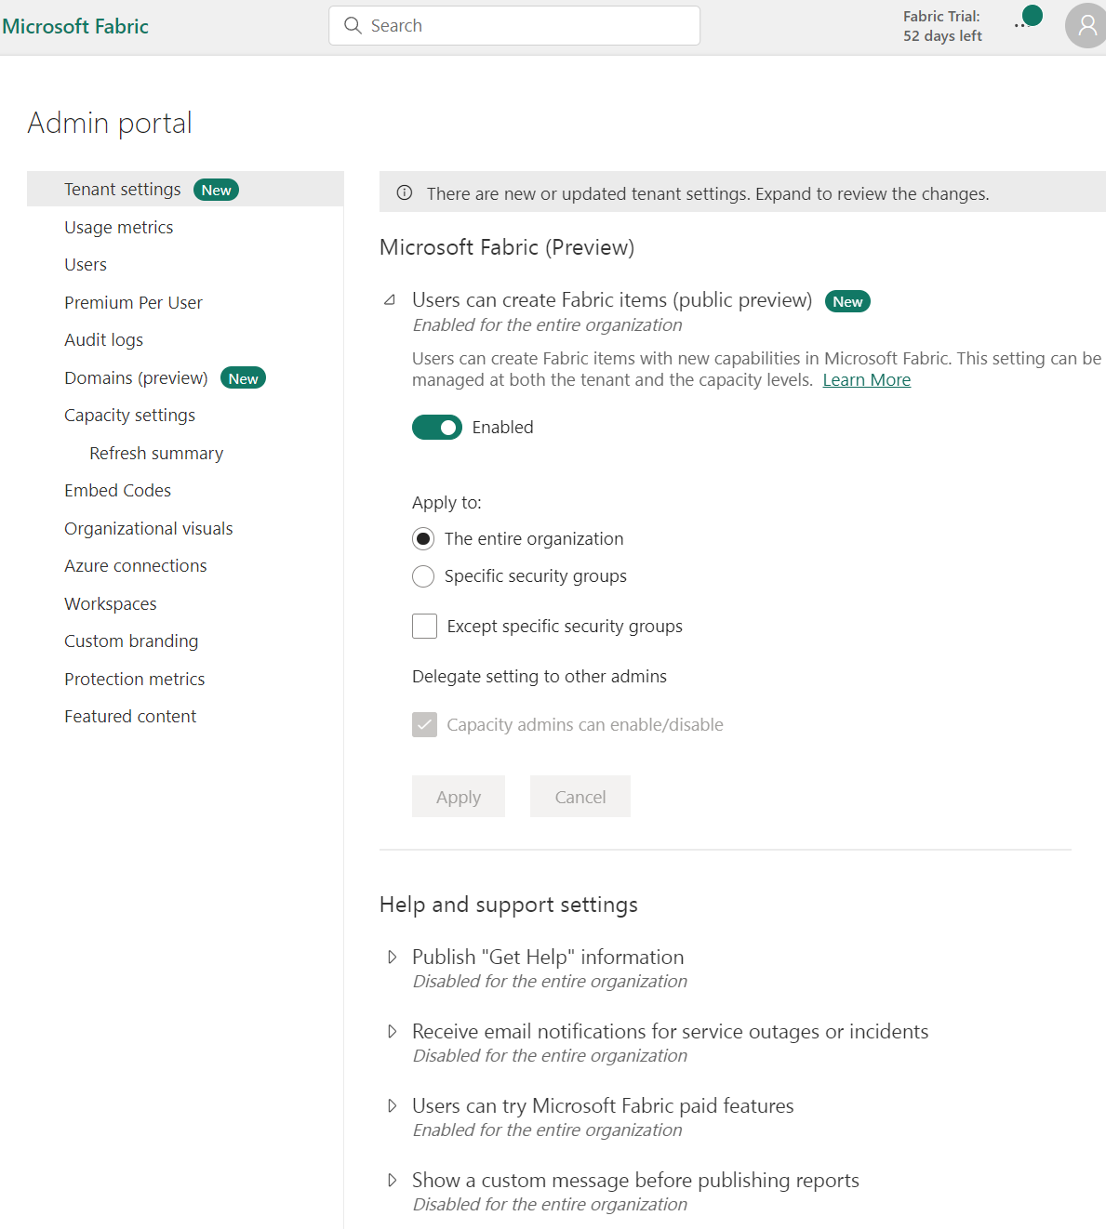
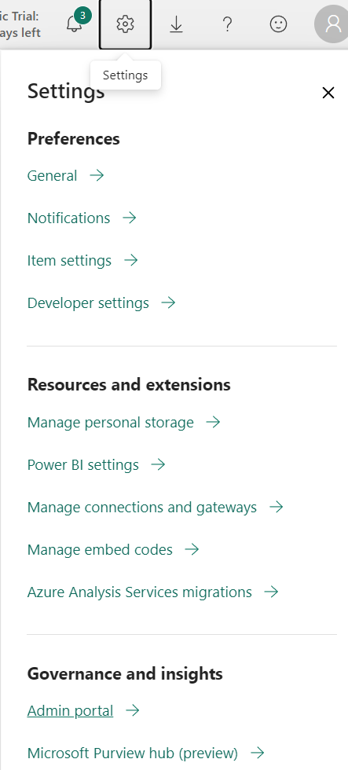
Org Access to Fabric
Enable Microsoft Fabric for your organization - Microsoft Fabric | Microsoft Learn
Notes:
Settings -> Admin Portal

Slide 30
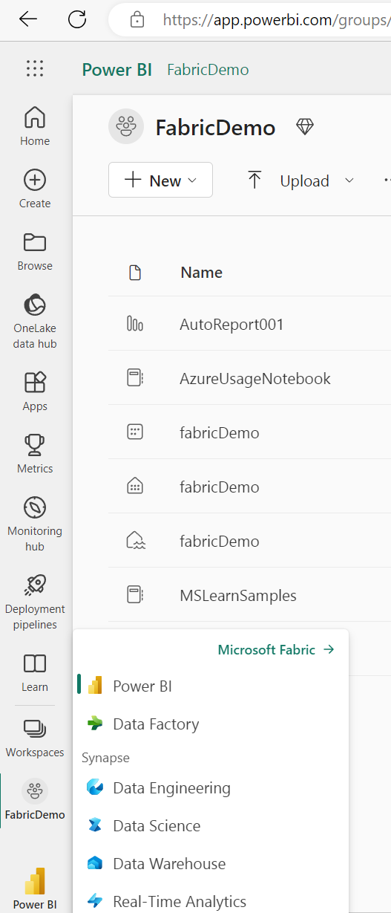
After install
Notes:
Data Engineering -> Use a Sample

Slide 31
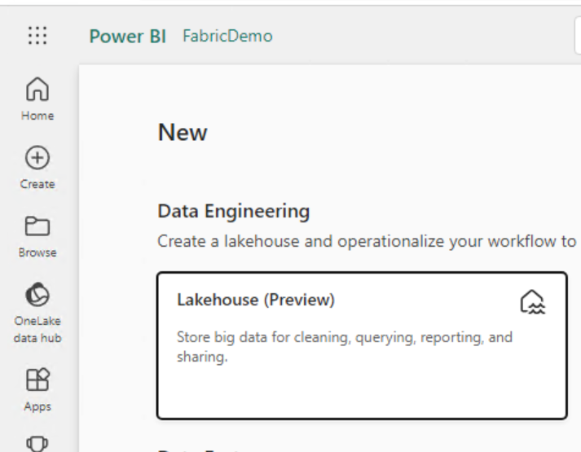
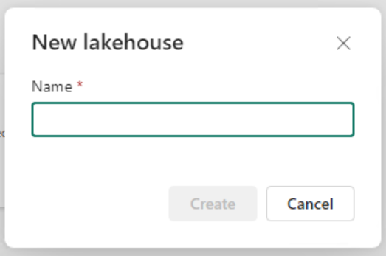
Create Lakehouse

Slide 32
SQL Endpoint
How do I connect?

Slide 33
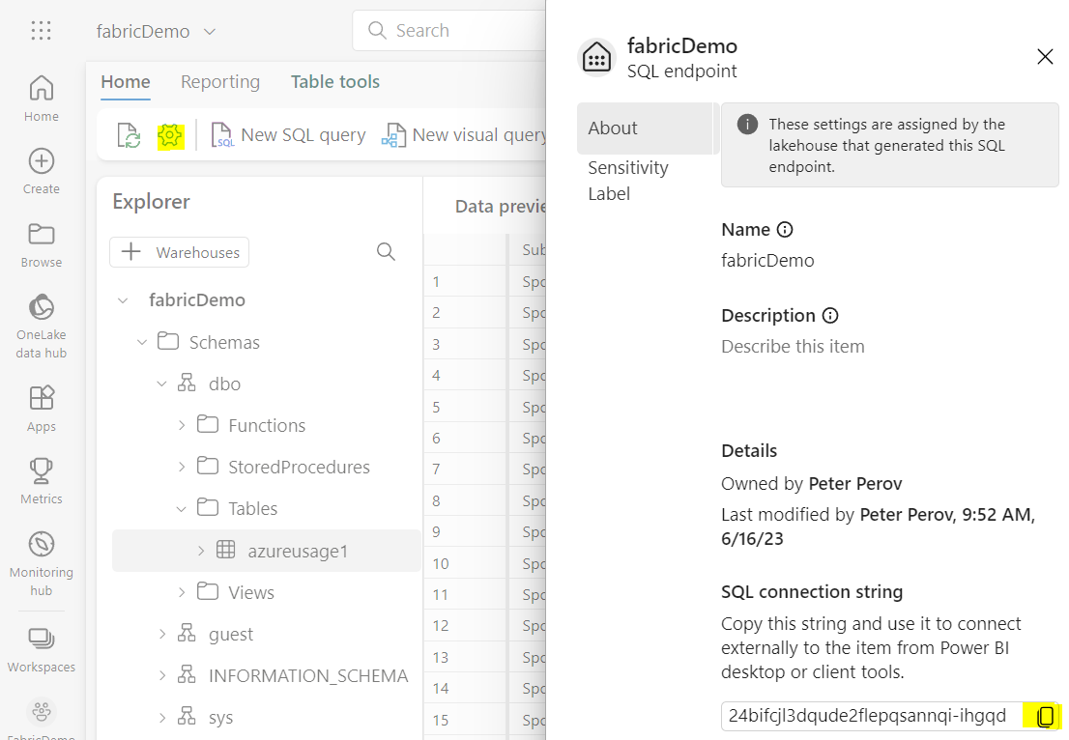
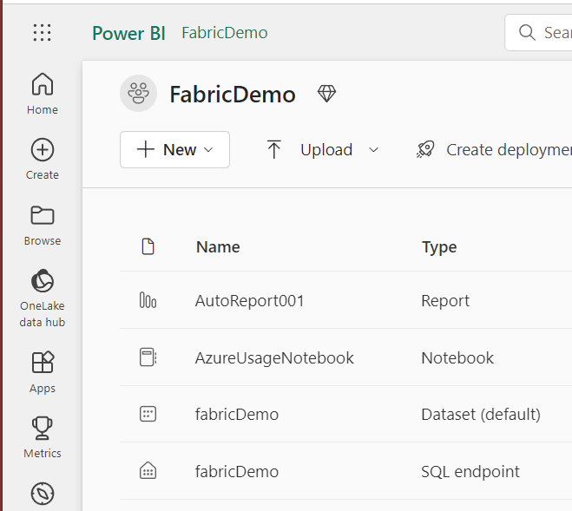
SQL Endpoint
Notes:
TDS endpoint?

Slide 34
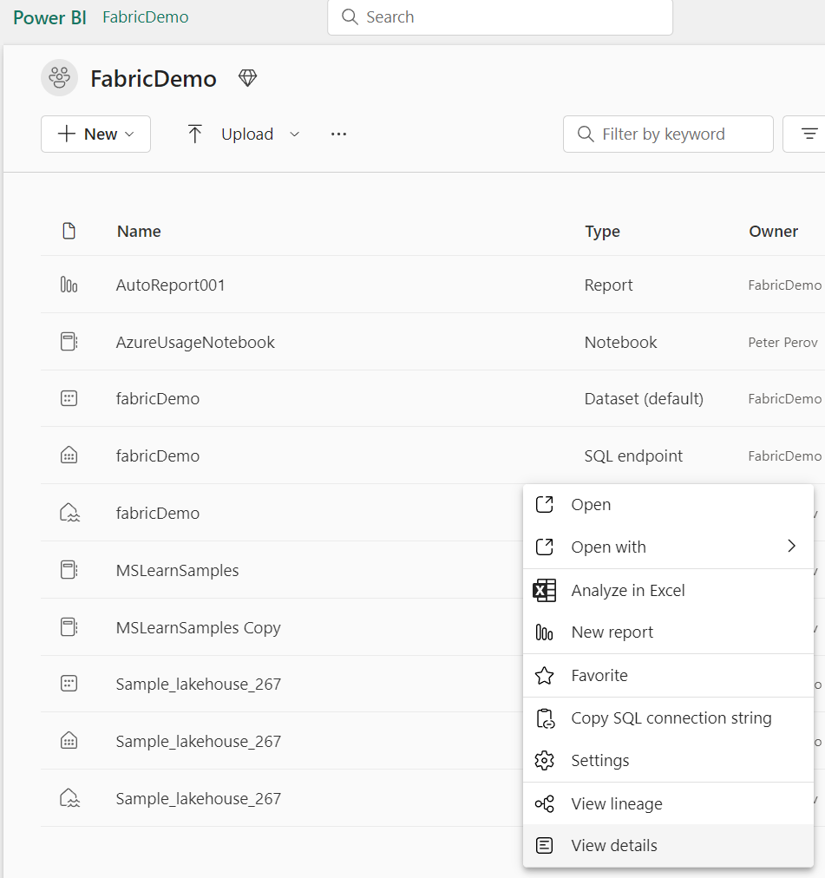
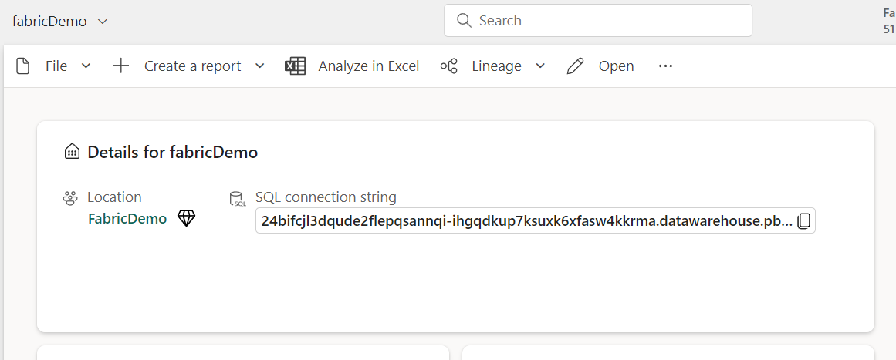
Alternatively

Slide 35
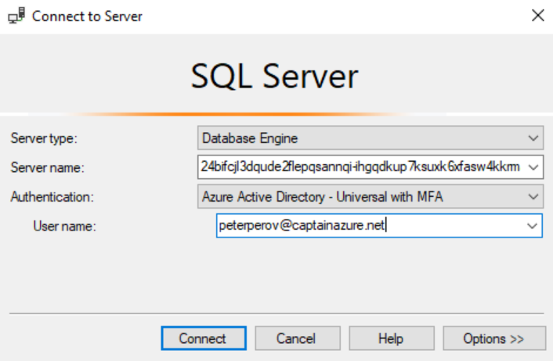
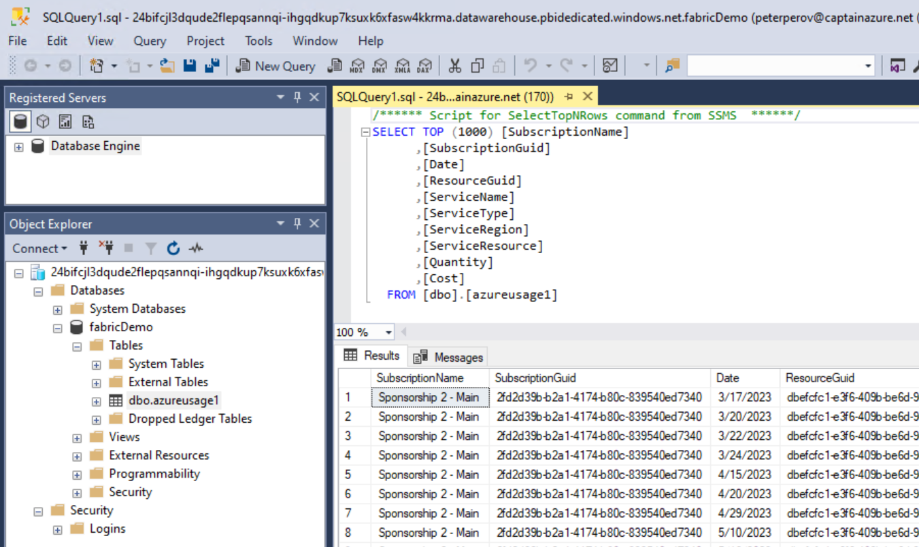
SSMS Connectivity

Slide 36
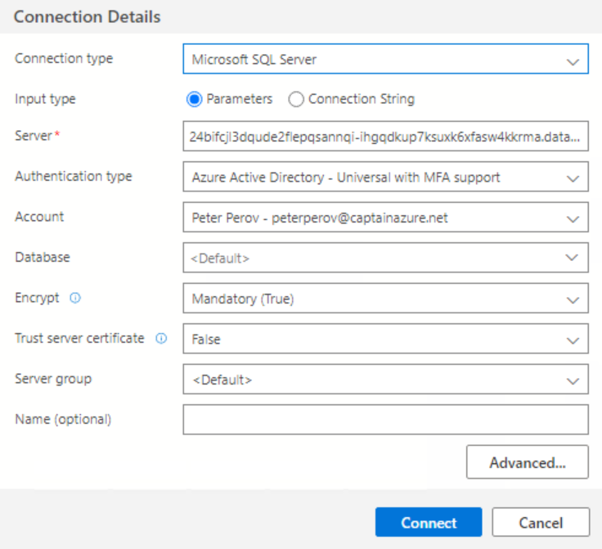
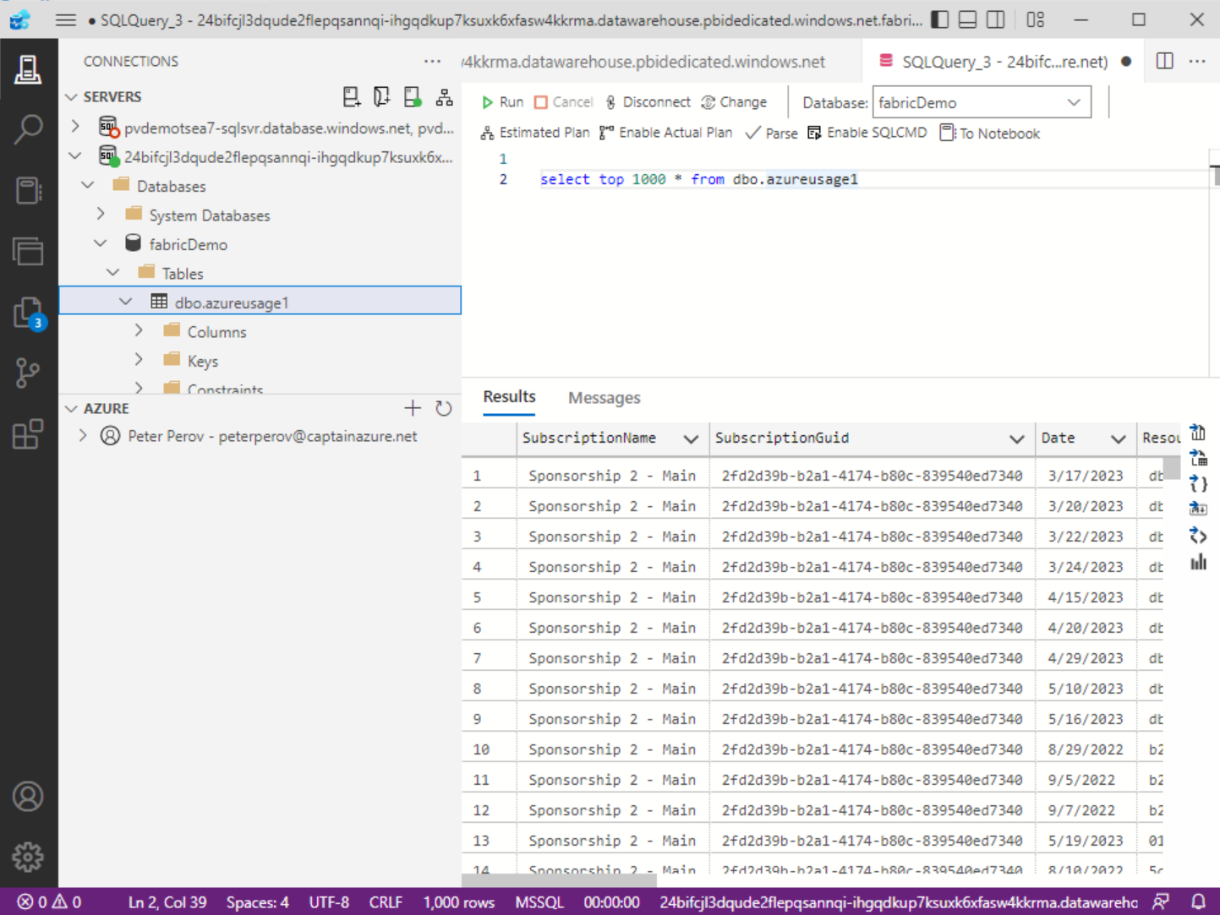
Azure Data Studio
Notes:
Or if you prefer…

Slide 37
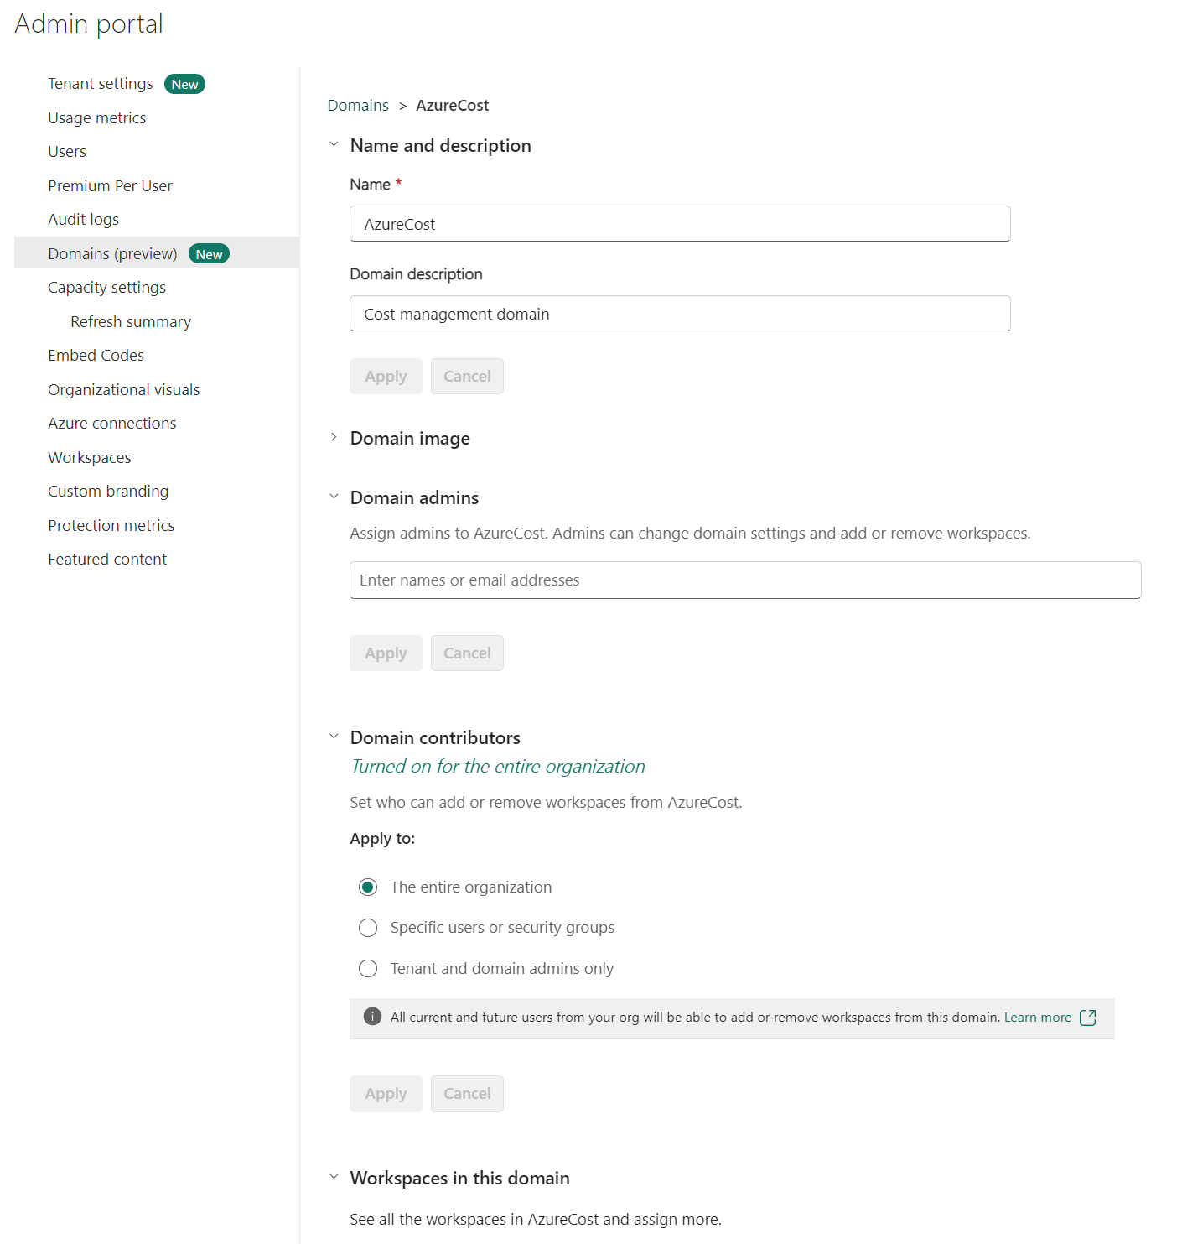
Domains
Notes:
Governance feature
Domains (preview)
https://learn.microsoft.com/en-us/fabric/governance/domains
What are Fabric domains?
In Fabric, a domain is a way of logically grouping together all the data in an organization that is relevant to a particular area or field. One of the most common uses for domains is to group data by business department, making it possible for departments to manage their data according to their specific regulations, restrictions, and needs.

Slide 38
Capacity Utilisation
How to monitor

Slide 39
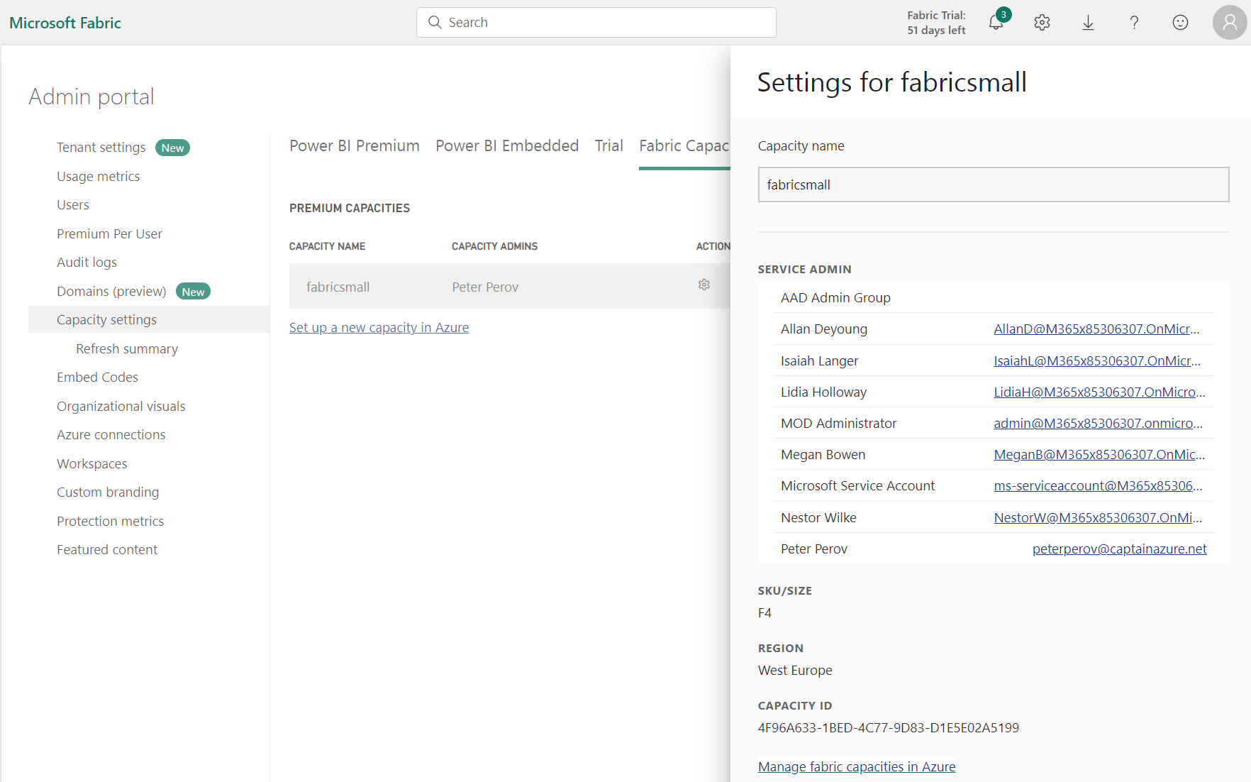
Get capacity Id
Admin portal
Capacity Settings
Actions

Slide 40
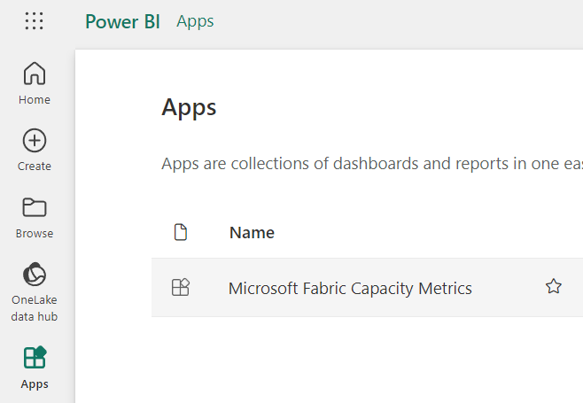
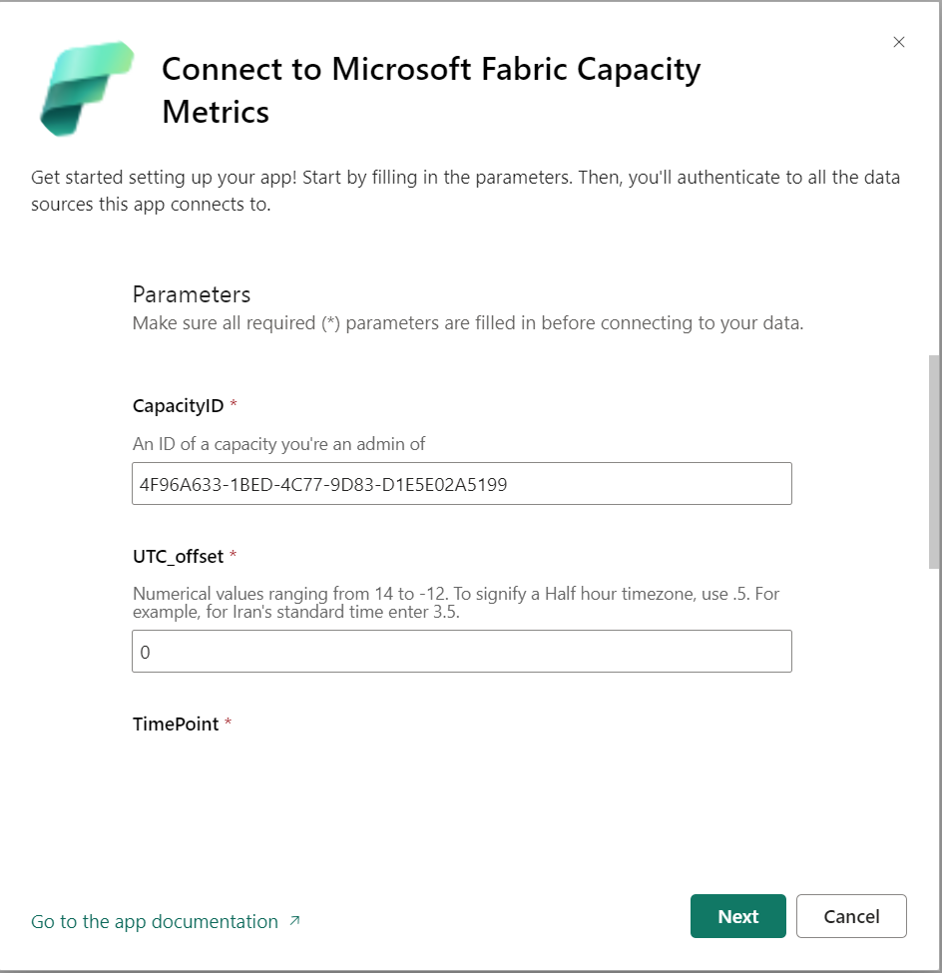
Install and configure Capacity Metric App
Install App
Connect with CapacityID
Notes:
https://learn.microsoft.com/en-us/fabric/enterprise/metrics-app-install?tabs=1st

Slide 41
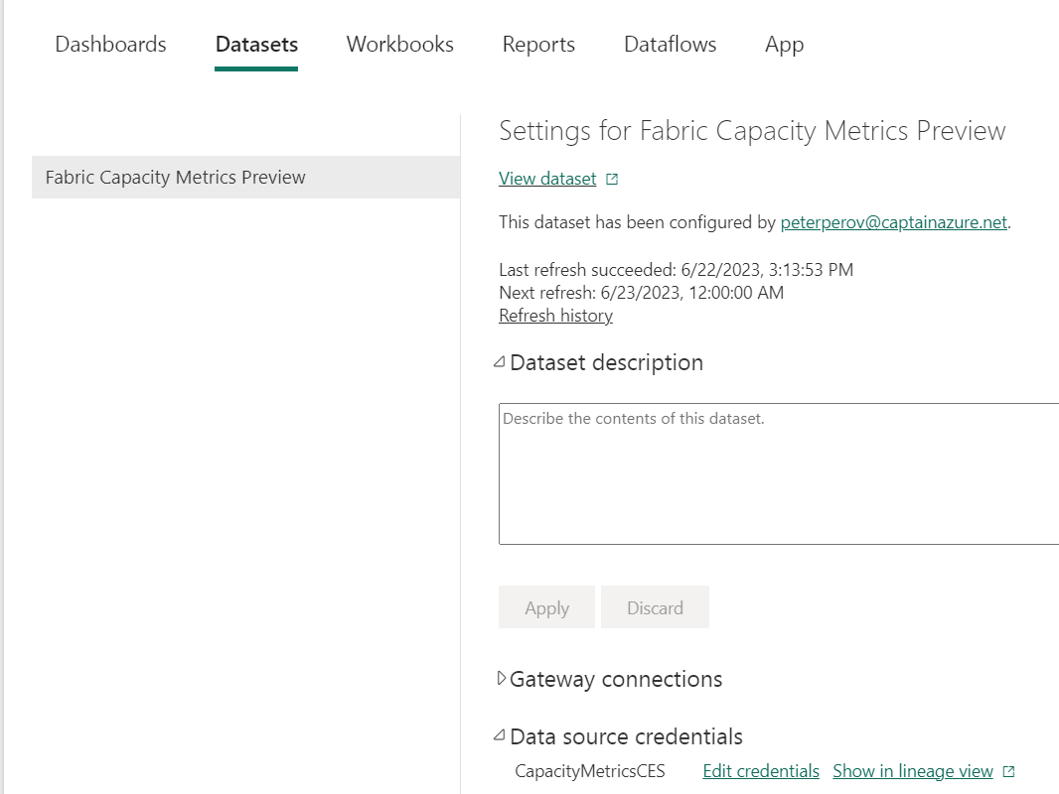
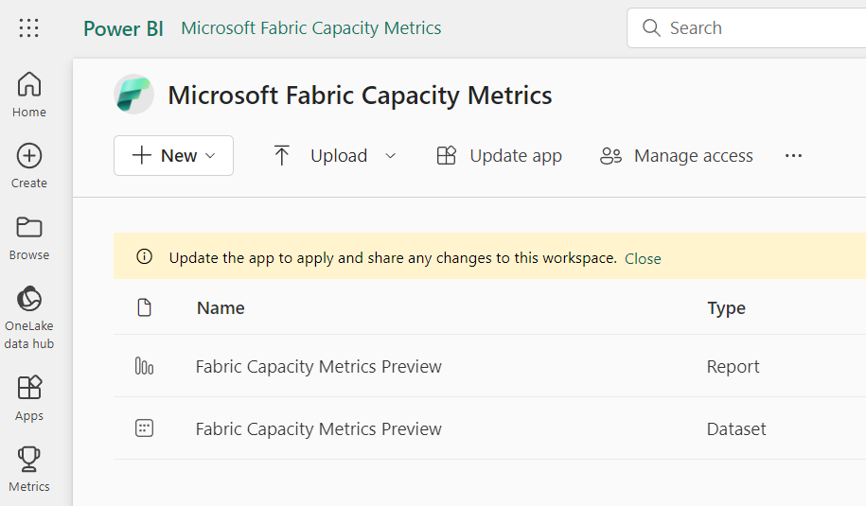
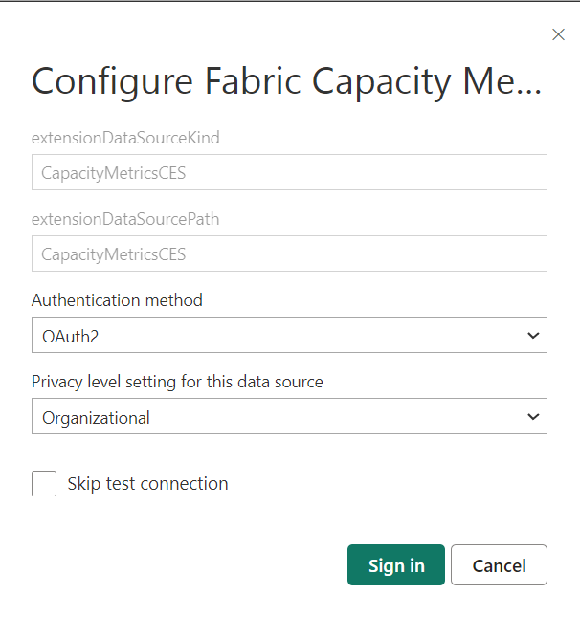
Setup credentials
Workspace -> Microsoft Fabric Capacity Metric
Click on Dataset properties
Configure Data Source Credentials

Slide 42
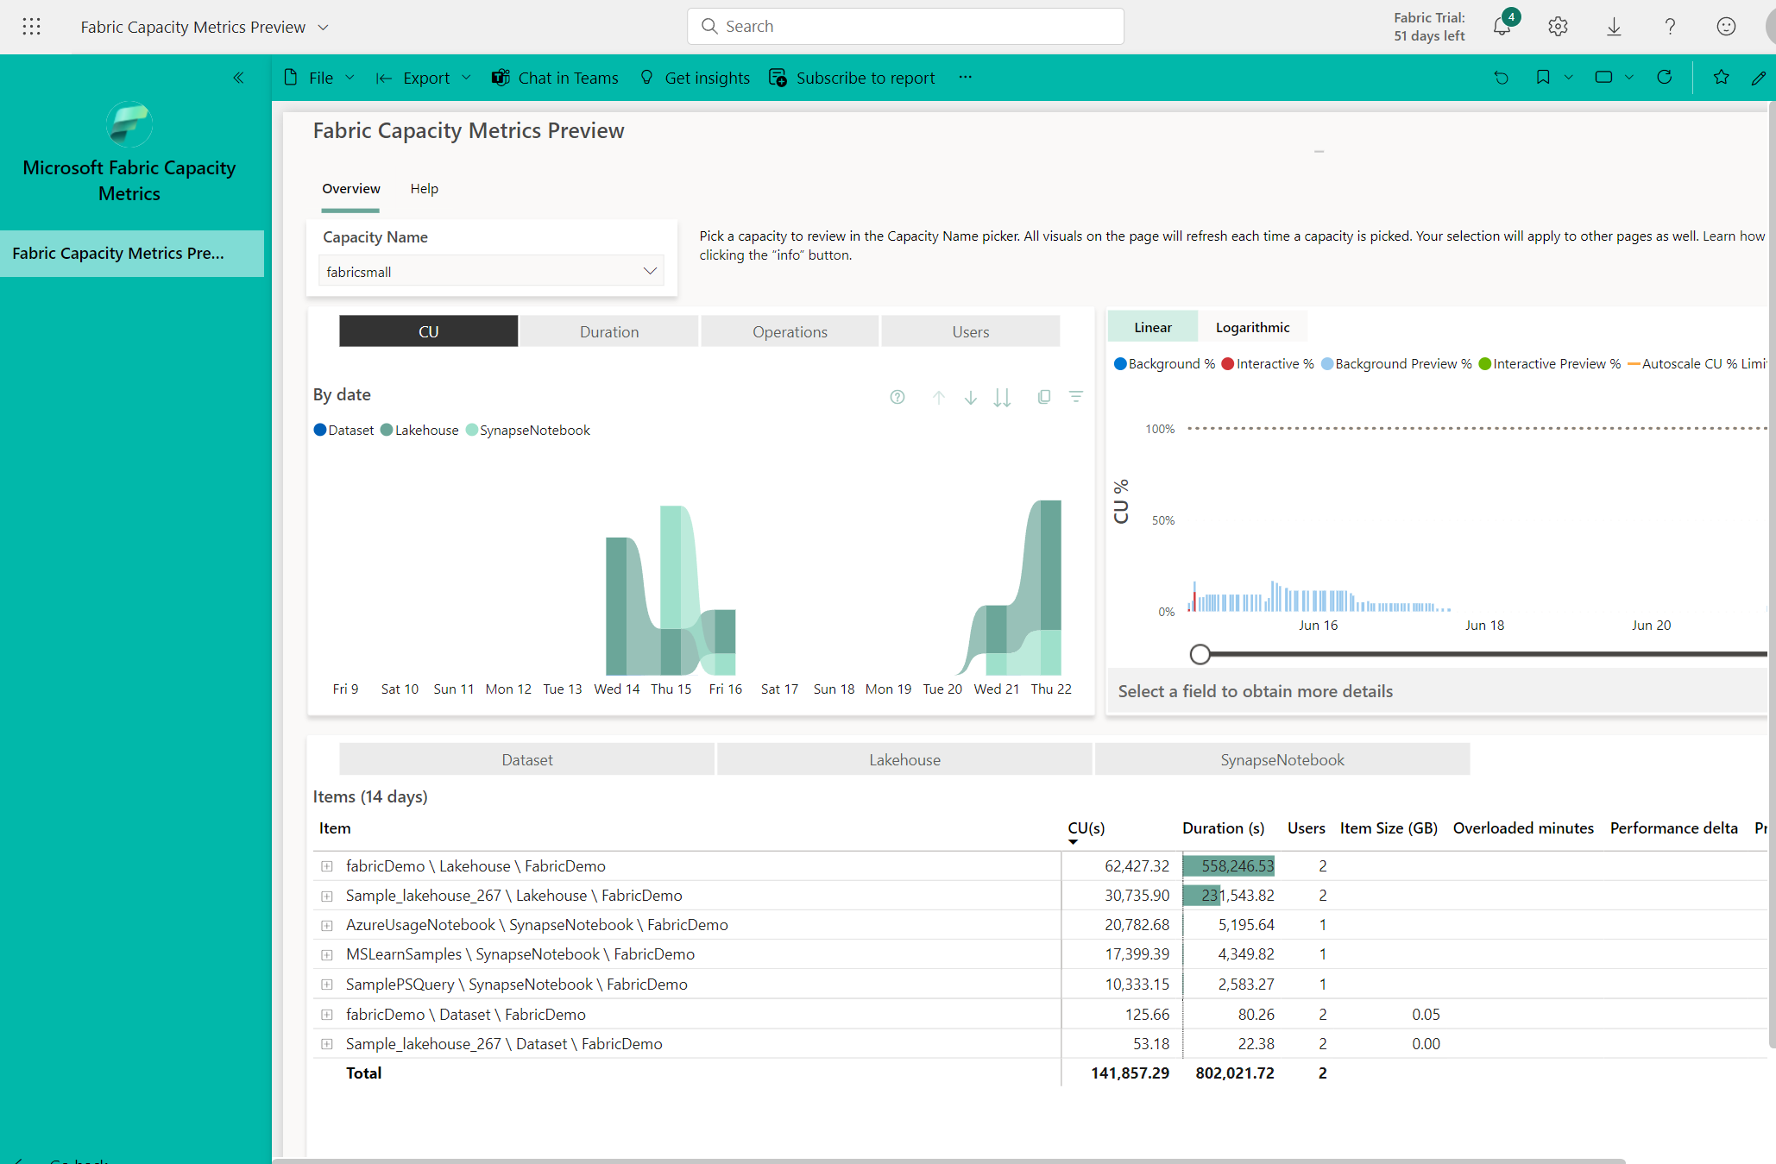

Slide 43
VM Setup
Joined to your M365 AAD tenant
Install OneLake File Explorer
Optional
SSMS
Azure Data Studio
Python
Anaconda
Notes:
OneLake File Explorer
https://learn.microsoft.com/en-us/fabric/onelake/onelake-file-explorer

Slide 44
Little Demo
Work with CSV file

Slide 45
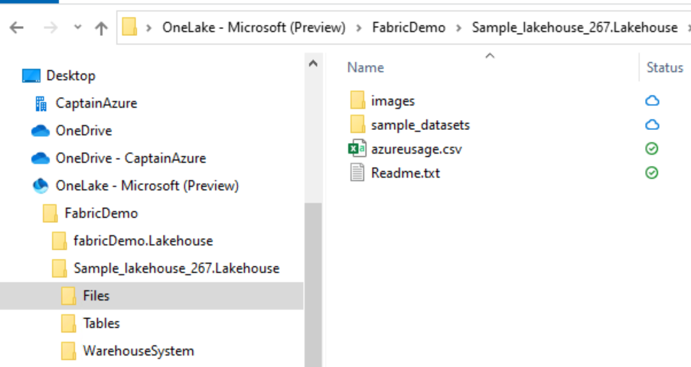
Take .csv file
CopyPaste csv file to the Lakehouse
Wait until it syncs

Slide 46
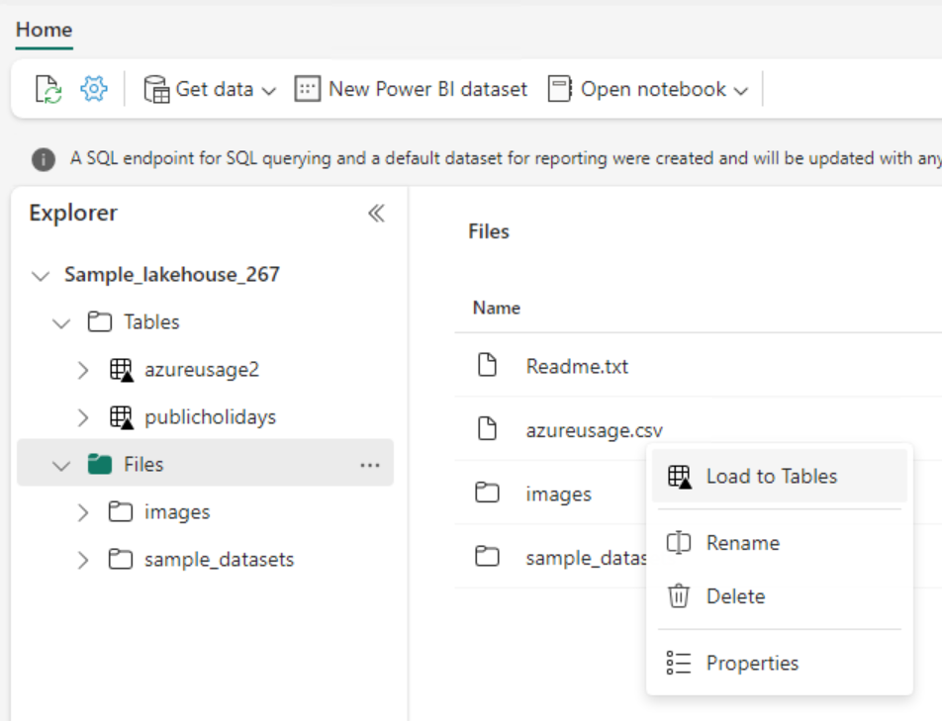
Load to tables
Select workspace
(List view)
Click on your Lakehouse
Load to Tables
Notes:
While it loads to tables, we can

Slide 47
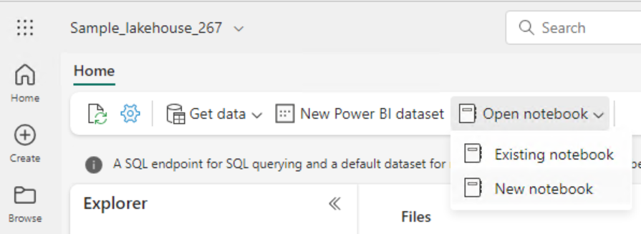
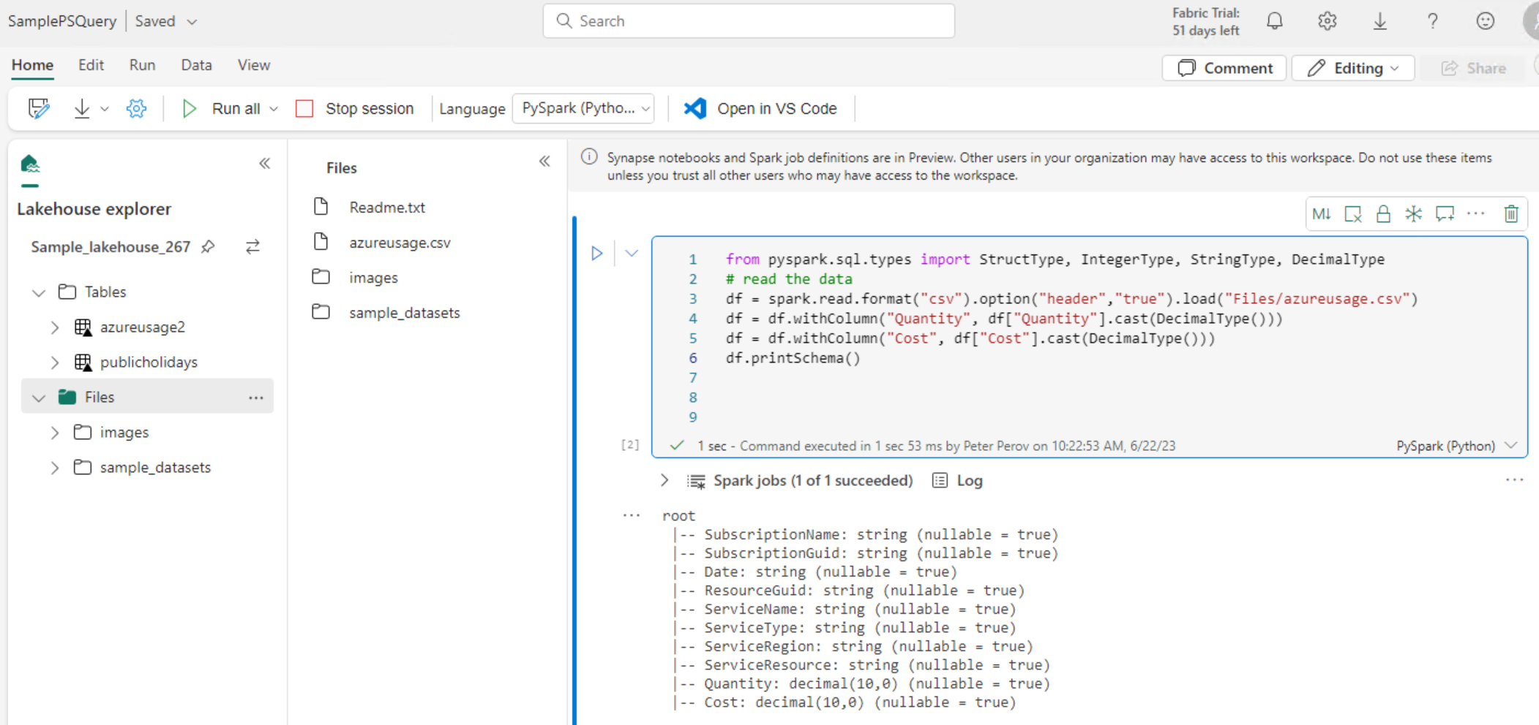
Query it with pyspark
Notes:
Make sure your Lakehouse is selected -> New Notebook
from pyspark.sql.types import StructType, IntegerType, StringType, DecimalType
# read the data
df = spark.read.format("csv").option("header","true").load("Files/azureusage.csv")
df = df.withColumn("Quantity", df["Quantity"].cast(DecimalType()))
df = df.withColumn("Cost", df["Cost"].cast(DecimalType()))
df.printSchema()
display(df.limit(10))
counts_df = df.select("ServiceName", "Cost").groupBy("ServiceName").sum("Cost")
display(counts_df)

Slide 48
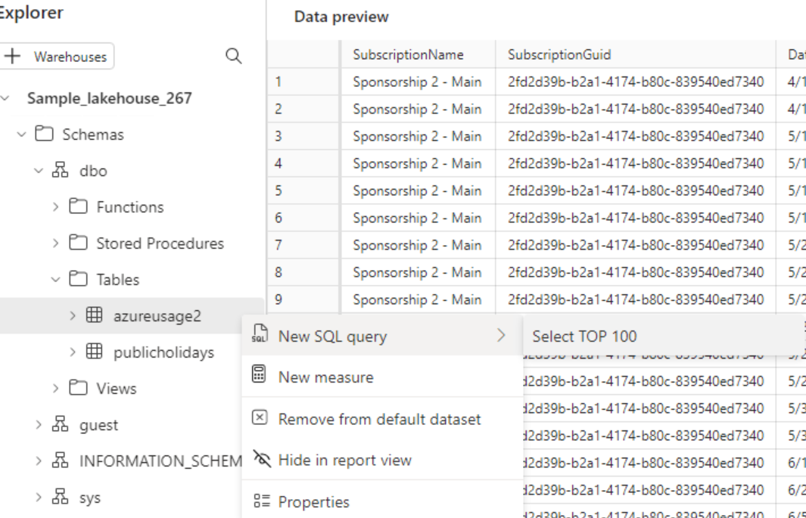
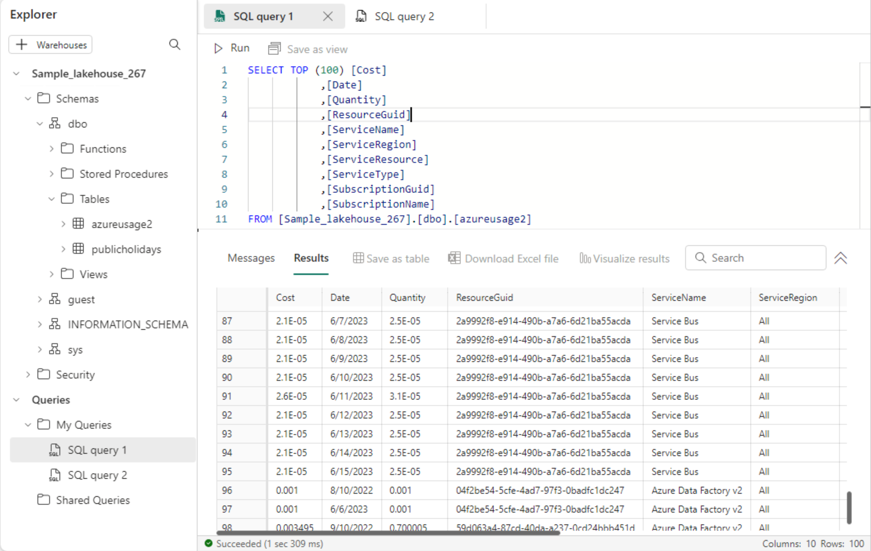
Query it with SQL
Notes:
-- object names are case sensitive
select * from INFORMATION_SCHEMA.COLUMNS

Slide 49
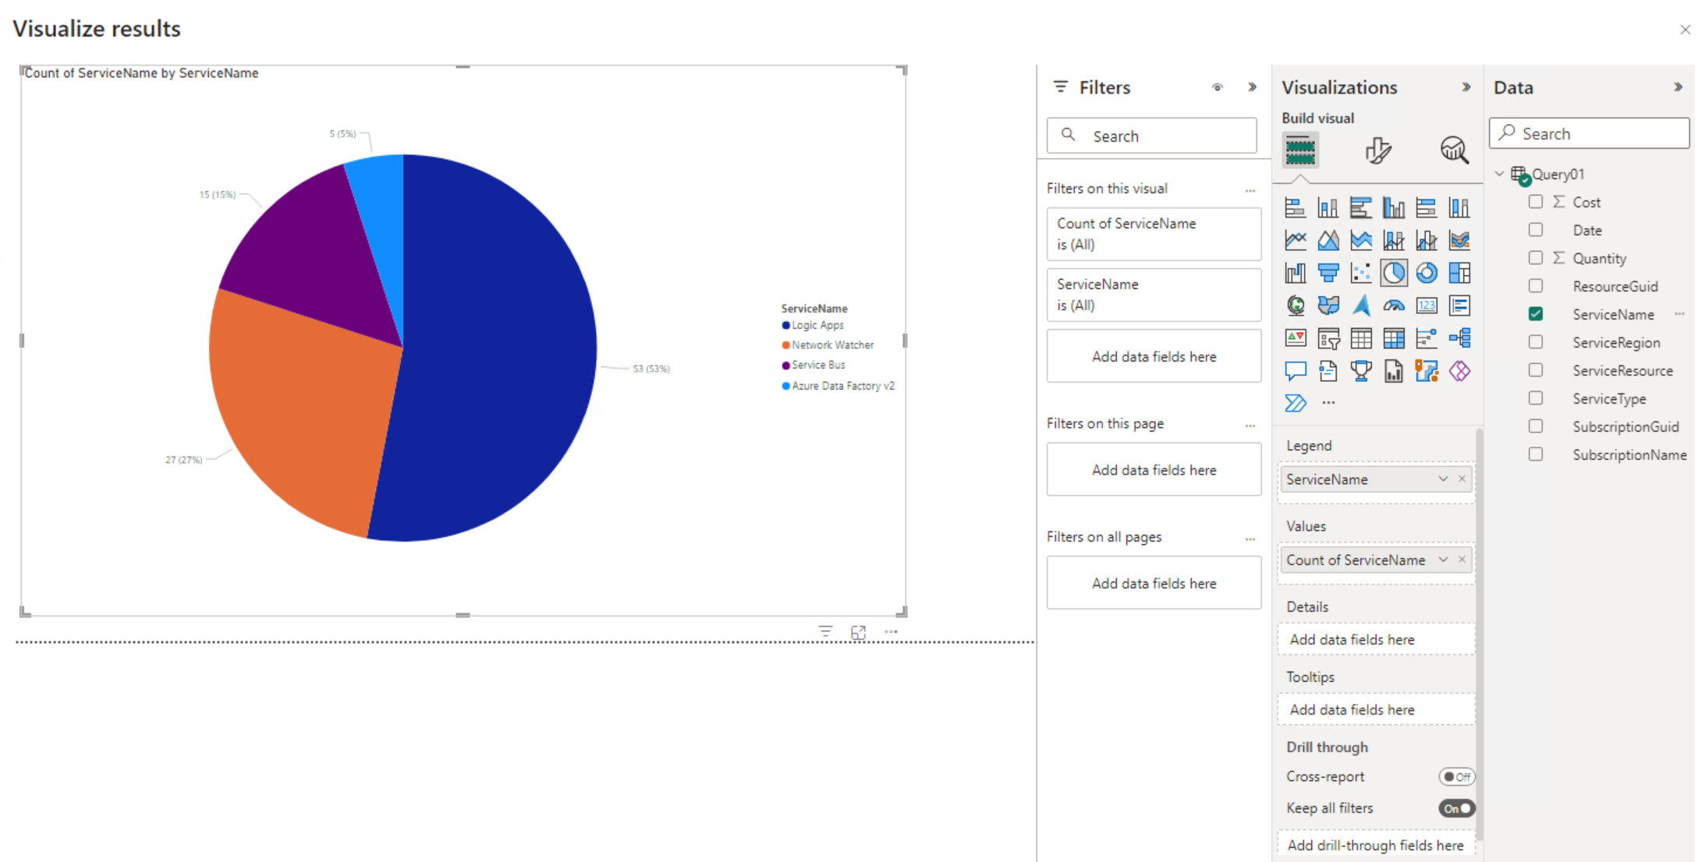
Quickly Visualise results
Notes:
Select “select” -> Visualise Results

Slide 50
Data files used
Azure subscription usage details
Adventure Works sample Excel
https://github.com/microsoft/powerbi-desktop-samples/tree/main/AdventureWorks%20Sales%20Sample

Slide 51
Parquet file
Parquet format only supports a single schema per file. This schema is written into the footer of the file and accounts for all sections of the file. You could probably reread the CSV file into pandas and save that as a Parquet file, but ultimately you will be better off when you save each table as a separate file. The latter should also be much more performant and space-efficient.

Slide 52
Dataset restrictions
Remove spaces from column names
Invalid column name(s) 'Sales Order, Sales Order Line'. Column names must contain UTF-8 encoded Unicode word characters and can be a maximum of 128 characters long. Unicode word characters include letters of any case and their nonspacing marks, punctuation connectors like the underscore(_), and decimal digits.
Remove spaces from sheet names

Slide 53
Other materials

Slide 54
Learning Resources
Get started with Microsoft Fabric
MSLearn: Use Apache Spark in Fabric
Microsoft Fabric exercises
End-to-end tutorials in Microsoft Fabric
Lakehouse end-to-end scenario: overview and architecture
YT: Guy in a Cube
Notes:
Plenty of good stuff!

Slide 55
Commercial Resources
Microsoft Fabric licenses

Slide 56
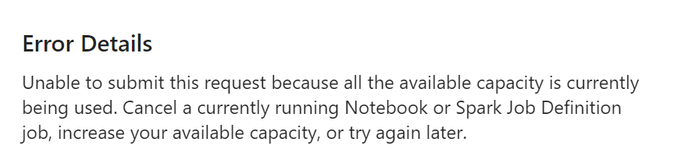
Troubleshooting
Errors can be misleading. In this case parquet file was not correct.
Notes:
We’re still in Preview

Slide 57
VS Code
Parquet file viewer
https://marketplace.visualstudio.com/items?itemName=dvirtz.parquet-viewer

